Slide 1
CS118 Assembly Language
Chapter 6-C++ Compilation and Linking Process

Slide 2
Section 1
Compiling

Slide 3
C++
I will use C and C++ to talk about compiling
The ideas are similar in other languages that are compiled to binary or assembly
The C++ compiler we will look at is the GNU C++ compiler
gcc is really a “front end” for many compilers
This means it’s a program that transforms programs in many languages to a common intermediate format

Slide 4
The Compilation Process
01

Slide 5
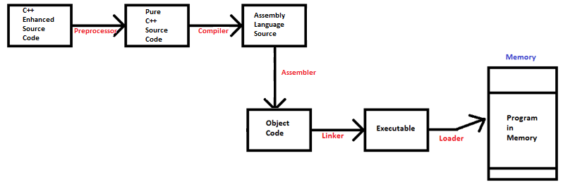
The Process

Slide 6
The C++ Preprocessor
02

Slide 7
The C++ Preprocessor
We already talked about that
The job of the preprocessor is to turn the file into pure C++ code
Much of this is processing lines that start with #
Some examples are
#include
#define

Slide 8
Some Details
#includes are expanded to actually include the source
A common ending for include files is .h
This is a holdover from C
Many C++ files don’t have extensions

Slide 9
More Details
It’s common to use #defines for two purposes
The first purpose is to define constants
#define MAX-DIMENSION 33
You can also define macros
The second is to give conditional compiles

Slide 10
Conditional Compiling-An Example
You can have a #include file that defines, for example
#define ARCHITECTURE 386
Later you can say (in your C++ code or another #include file)
#ifdef ARCHITECTURE
…
…
#endif

Slide 11
Conditional Compiling-Why?
There is a huge advantage to the use of #if
You can write source code to run on, for example, Macs and Windows PCs
The use of #ifdef in this way is quite common
Again, this is handled by the preprocessor

Slide 12
The Actual Compilation Process
03

Slide 13
The GNU C++ Compiler
The compiler actually produces assembly code
You can see this code if you compile with the –S switch

Slide 14
A Sample C++ Program
int add_three (int a, int b, int c)
{
return a+b+c;
}
int main ()
{
int d = add_three (2, 4, 5);
cout << "The sum is " << d << endl;
}

Slide 15
The Generated Code-add_three
_Z9add_threeiii:
pushl %ebp
movl %esp, %ebp
movl 8(%ebp), %edx
movl 12(%ebp), %eax
addl %eax, %edx
movl 16(%ebp), % eax
addl %edx, %eax
popl %ebp
ret

Slide 16
Things to Notice
The name got changed to Z9add_threeiii
This is to avoid conflicts with other labels
It’s common for compilers to generate labels like this
They also generate labels that start with one or two underscores

Slide 17
Subroutine Linkage
The add_three function has three parameters
Let’s trace the generated code in the function
The first line (pushl %ebp) pushes the ebp register onto the stack
This saves ebp onto the stack
This frees ebp to be used in the subroutine
The next line stores esp in ebp
This creates a stack frame

Slide 18
A New Form of Register Addressing
We see instructions that contain 8(%ebp)
This is a new way of addressing data
It’s called indexed addressing
This means
Take the value in ebp
Add 8 to that
Use the final value as the address of the data
This is like saying
(8_+ %ebp), but that is not valid in assembler

Slide 19
Retrieving the Arguments
esp points to the top of the stack
The stack looks like this
return address (8 byes)
first argument (4 bytes)
second argument (4 bytes)
third argument (4 bytes)
So, the instruction
movl 8(%ebp), %edx
copies the first argument into edx

Slide 20
The Process Continues
The next instruction moves the second argument to eax
The next instruction adds eax to edx
The next instruction puts the third argument into eax
The next instruction adds edx to eax
The next instruction pops the saved value of ebp
The function then returns

Slide 21
Setting up for the Function
This code is in main ()
This is the translated code for
add_three (2,4,8)
movl $5, 8(%esp)
movl $4, 4(%esp)
movl $2, (%esp)
call __Z9add_threeiii

Slide 22
The Symbol Table
04

Slide 23
Number of Passes
Some compilers are single pass, and some are multipass
The number of passes refers to how many times the compiler scans through the code
Compare the two programs on the next slide

Slide 24
C++ vs. Java
C++ | Java
int main () { int x = 5; cout << x; print_line(); } void print_line() { cout << endl; } | public static void main (String [] args) { int x = 5; System.out.print (x); printLine(); } public static void printLine() { System.out.println(); }

Slide 25
Comparing the Programs
One of these programs will not compile
Which is it?
One of these compilers is a single pass compiler and the other is multi-pass
The multipass compiler will resolve the forward reference to print_line()
The single pass compiler will not

Slide 26
The Symbol Table
When a compiler encounters a user-defined symbol (function/method name, variable name, etc.) it builds an entry in the symbol table
The entry contains information about each symbol, such as
an offset into the data section
a line number
the symbol’s type
the scope of the symbol

Slide 27
A Single Pass Compiler
After a single pass compiler has processed the source code, it checks the symbol table
If there are undefined symbols, it gives errors
This is what happens in C++

Slide 28
A Multipass Compiler
A multiple pass compiler processes the source code over and over, until the number of undefined symbols stops decreasing
Once the number of undefined symbols stabilizes, there are two possible outcomes
If there are undefined symbols, it gives errors
This is what happens in Java

Slide 29
Symbol Tables
Symbol tables are used in assemblers, compilers and other software
There are many other uses of symbol tables
Other uses of a symbol table include
Translating code to binary
The offset is calculated once and used repeatedly
Resolving symbol conflicts
for (int i =0; …
Which i is it?

Slide 30
An In-Depth Look at the Linker
05

Slide 31

The End of the Assembly Process
We are focusing on these steps

Slide 32
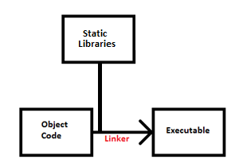
A Picture with Details

Slide 33
Static Libraries
Code for pre-defined functions is stored in a library
You can write your own code and store it in your own libraries
Any code which doesn’t change, such as the binary code for the square root function, is stored in a static library
Modules in a static library are physically added to the object module
They are part of the executable

Slide 34
Dynamic Libraries
Code for functions which change often or is heavily system-dependent is stored in a dynamic library
On Windows, these are called dll files
For modules in a dynamic library, the code is not added to the object code
Only a pointer to the module is added
This is like our subroutine call

Slide 35
Static vs. Dynamic Libraries
People often say compile-time to refer to a static library
People often say runtime to refer to a dynamic library

Slide 36
Linux ELF files
A common format for a Linux executable is ELF format
It creates a relocatable executable format
Relocatable means that the program can be loaded anywhere in memory
The next slide has some information from an ELF file header

Slide 37
Some Information in an ELF Header
Class: ELF64
Data: 2's complement, little endian
OS/ABI: UNIX - System V
Type: REL (Relocatable file)
Machine: Advanced Micro Devices X86-64
Entry point address: 0x0
Start of program headers: 0 (bytes into file)
Start of section headers: 848 (bytes into file)

Slide 38
ld in the C++ Process
Notice that ld is called in the C++ process
It’s the same thing we do
It’s invisible to a C++ programmer
This is true for any language that is compiled to binary

Slide 39
CREDITS!
CREDITS: This presentation template was created by Slidesgo, including icons by Flaticon, and infographics & images by Freepik.

